Slide 1
Twitter Sentiment Analysis Based on Ordinal Regression
PRESENTED BY
Jayesh Mandava
(161FA07081)

Slide 2
Introduction To Project
With the rapid development of social networks and microblogging websites. Microblogging websites have become one of the largest web destinations for people to express their thoughts, opinions, and attitudes about different topics. Twitter is a widely used microblogging platform and social networking service that generates a vast amount of information. In recent years, researchers preferably made the use of social data for the sentiment analysis of people’s opinions on a product, topic, or event. Sentiment analysis, also known as opinion mining, is an important natural language processing task. This process determines the sentiment orientation of a text as positive, negative, or neutral

Slide 3
ABSTRACT
Research on Twitter sentiment analysis, which analyzes Twitter data (tweets) to extract user sentiments about a topic, has grown rapidly. Many researchers prefer the use of machine learning algorithms for such analysis. This study aims to perform a detailed sentiment analysis of tweets based on ordinal regression using machine learning techniques. The proposed approach consists of first pre-processing tweets and using a feature extraction method that creates an efficient feature. Then, under several classes, these features scoring and balancing. Multinomial logistic regression (SoftMax), Support Vector Regression (SVR), Decision Trees (DTs), and Random Forest (RF) algorithms are used for sentiment analysis classification in the proposed framework. For the actual implementation of this system, a twitter dataset publicly made available by the NLTK corpora resources is used. Experimental findings reveal that the proposed approach can detect ordinal regression using machine learning methods with good accuracy. Moreover, results indicate that Decision Trees obtains the best results outperforming all the other algorithms.

Slide 4
EXISTING SYSTEM
The current study mainly focuses on the sentiment analysis of Twitter data (tweets) using different machine learning algorithms to deal with ordinal regression problems. In this paper, we propose an approach including pre-processing tweets, feature extraction methods, and constructing a scoring and balancing system, then using different techniques of machine learning to classify tweets under several classes.
Twitter sentiment analysis approaches can be generally categorized into two main approaches, the machine learning approach, and a lexicon-based approach. In this study, we use machine learning techniques to tackle twitter sentiment analysis. Most classification algorithms are focused on predicting nominal class data labels. However, a rule for predicting categories or labels on an ordinal scale involves many pattern recognition issues. This type of problem, known as ordinal classification or ordinal regression. Rece

Slide 5
PROPOSED SYSTEM
The proposed system is basically composed of four main modules. The first module is data acquisition, which is a process of gathering labeled tweets to perform sentiment analysis; the second module, this dataset undergoes various steps of preprocessing to transform and refine tweets into a data set that can be easily used for subsequent analysis. The third module concerns the extraction of relevant features for building a classification model. Then, the balancing and scoring tweets technique is illustrated. The last module is applying different machine learning classifiers that classify the tweets into high positive, moderate positive, neutral, moderate negative, and high negative. Figure 1 shows the various steps performed for sentiment analysis using machine learning algorithms
the proposed model can detect ordinal regression in Twitter using machine learning methods with a good accuracy result. The performance of the model is measured using accuracy, Mean Absolute Error, and Mean Squared Error.

Slide 6
ADVANTAGES OF PROPOSED SYSTEM:
Machine learning techniques to solve regression problems to improve the sentiment analysis classification of Twitter data performance and predict new results. The main advantage of this method is the achievement of improved results.
Another advantage of our model is that our technique for sentiment polarity is also different as we deal with five categories of sentiment (highly positive, moderate positive, neutral, moderate negative, and highly negative) and therefore cannot apply their approach directly

Slide 7
Algorithm :-
Preprocessing Tweets.

Slide 8
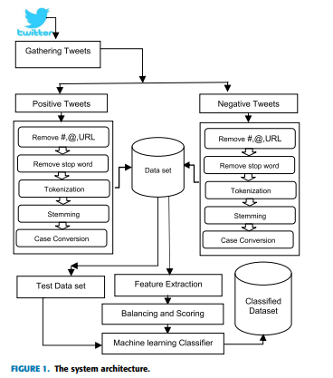
System Architecture

Slide 9
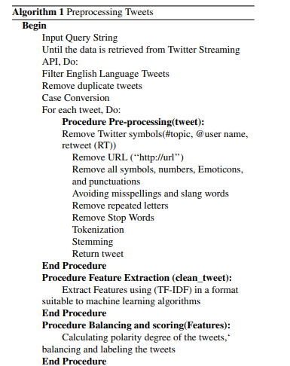
Algorithm

Slide 10
Modules
Load NLTK Tweets:
Using this module we will load twitter sentiment corpora dataset from NLTK library.
Read NLTK Tweets:
Using this module we will read tweets from NLTK and then clean tweets by removing special symbols, stop words and then perform stemming (stemming means removing ing or tion from words for example ORGANIZATION word will become ORGANIZE after applying stem) on each words. Then we will calculate TFIDF vector.
Run SVR Algorithm:
In this module we will give TFIDF vector as input to train SVR algorithm. This algorithm will take 80% vector for train and 20% vector as test. Then algorithm applied 80% trained model on 20% test data to calculate prediction accuracy.

Slide 11
Modules
Similarly we will build model for Random Forest and Decision tree to calculate their accuracy.
Detect Sentiment Type:
Using this module we will upload test tweets and then application will apply train model on those test tweets to predict sentiment of that tweet.
Accuracy Graph:
Using this module we will display accuracy graph between all algorithms.

Slide 12
HARDWARE REQUIREMENTS
Operating System supported by
1. Windows 7
2. Windows XP
3 . Windows 8
Processor – Pentium IV or higher
RAM -- 256 MB
Space on Hard Disk -- Minimum 512 MB

Slide 13
SOFTWARE REQUIREMENTS
For developing the Application
1. Python
2. Django
3. Mysql
4. Mysqlclient
5. WampServer 2.4
Technologies and Languages used to Develop
-- Python

Slide 14
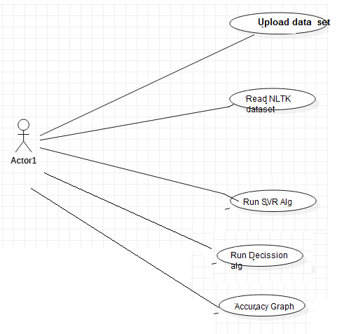
UML Diagrams
Usecase Diagrams :-

Slide 15
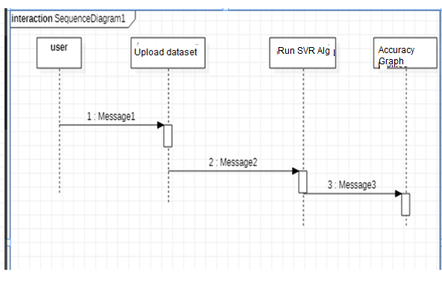
UML Diagrams
Sequance Diagrams :-

Slide 16
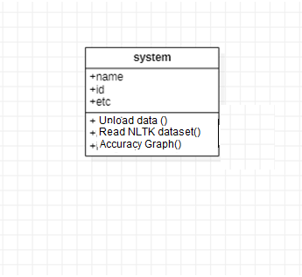
UML Diagrams
Class Diagram :-

Slide 17
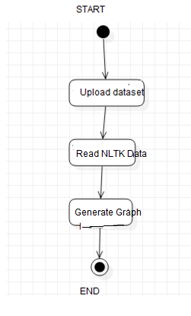
UML Diagrams
Activity Diagram :-

Slide 18
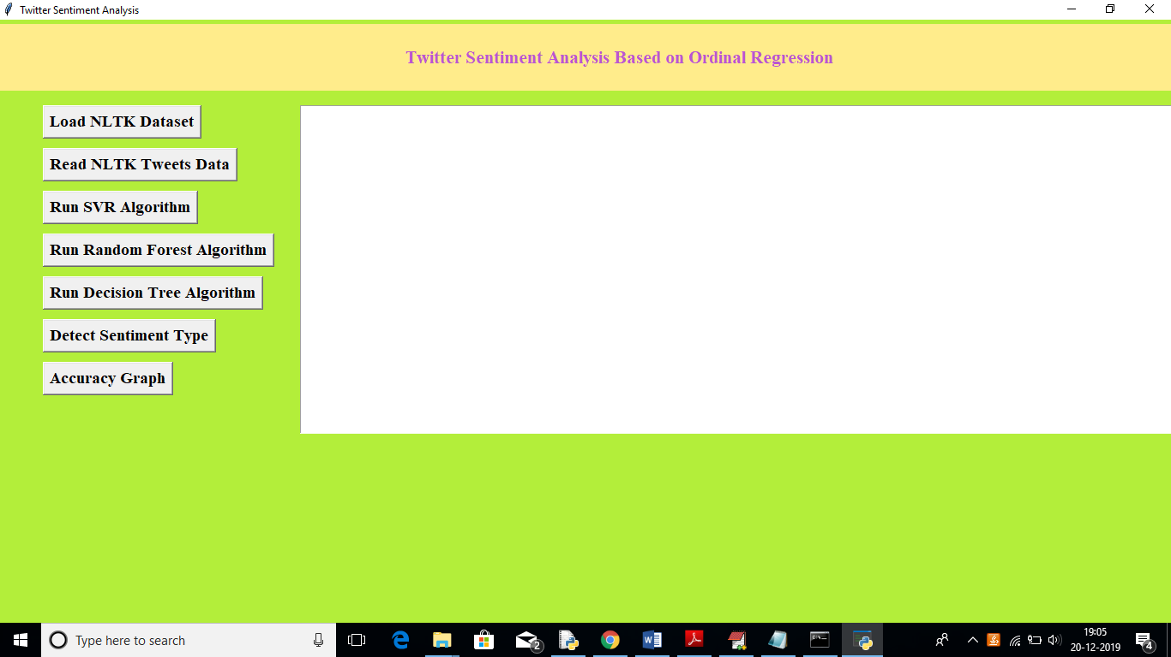
SCREEN SHOTS

Slide 19
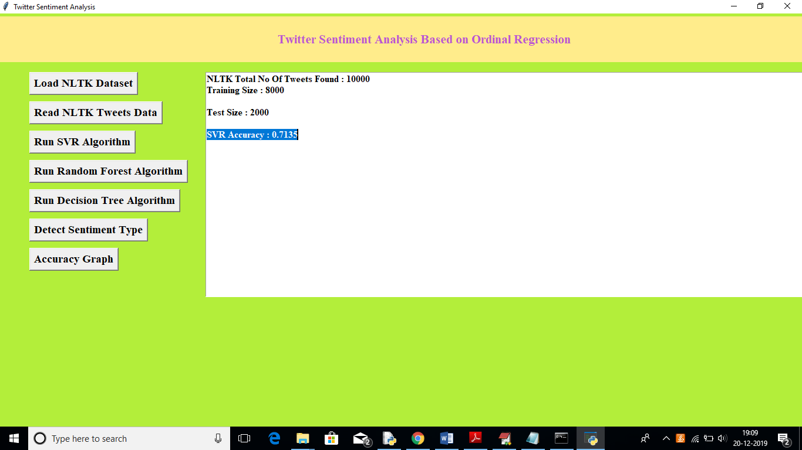

Slide 20
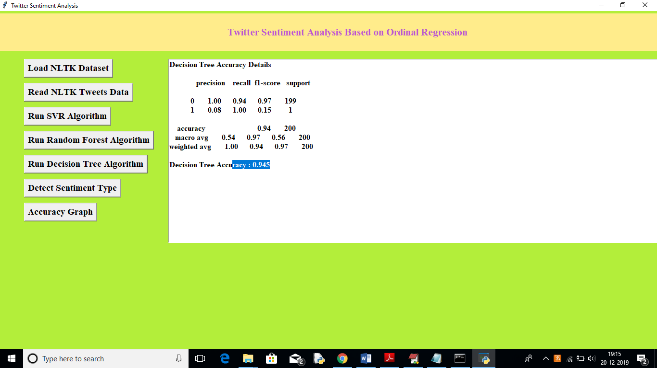

Slide 21
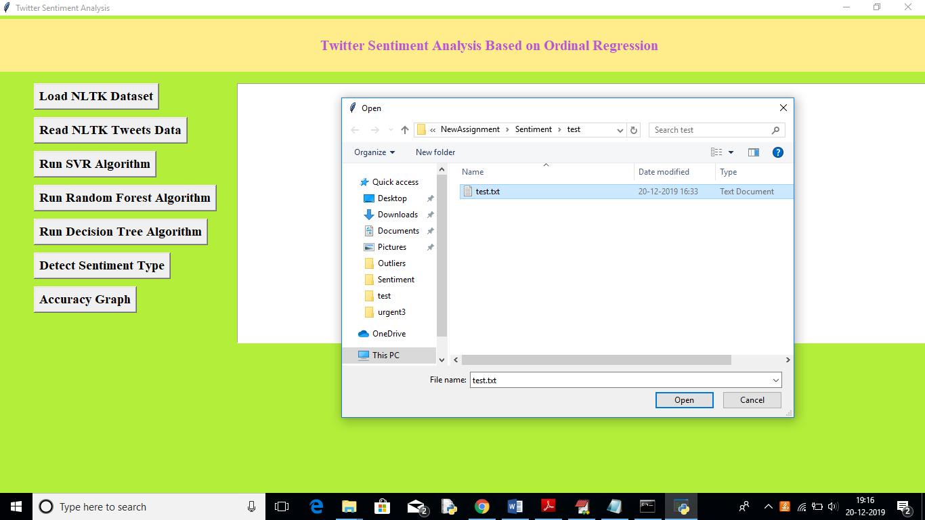

Slide 22
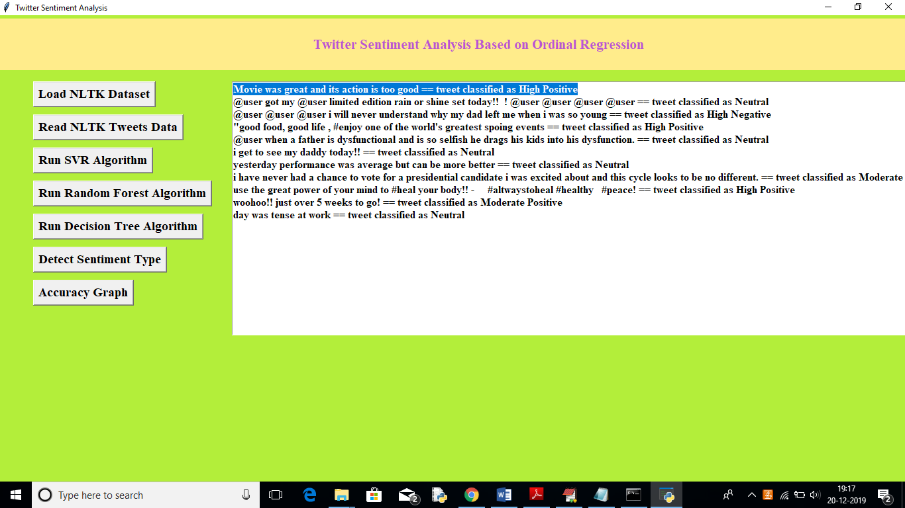

Slide 23
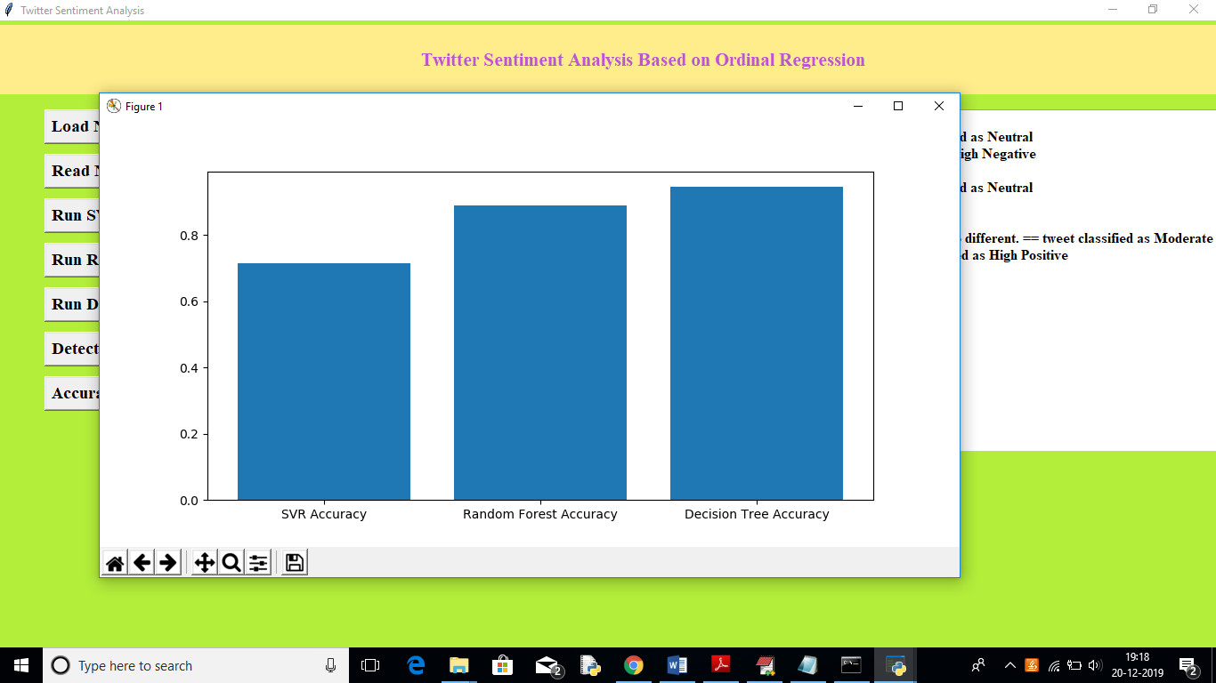

Slide 24
Conclusion
This study aims to explain sentiment analysis of twitter data regarding ordinal regression using several machine learning techniques. In the context of this work, we present an approach that aims to extract Twitter sentiment analysis by building a balancing and scoring model, afterward, classifying tweets into several ordinal classes using machine learning classifiers. Classifiers, such as Multinomial logistic regression, Support vector regression, Decision Trees, and Random Forest, are used in this study. This approach is optimized using Twitter data set that is publicly available in the NLTK corpora resources. Experimental results indicate that Support Vector Regression and Random Forest have an almost similar accuracy, which is better than that of the Multinomial logistic regression classifier. However, the Decision Tree gives the highest accuracy at 91.81%..

Slide 25
Feature work
In the future, we plan to improve our approach by attempting to use bigrams and trigrams. Furthermore, we intend to investigate different machine learning techniques and deep learning techniques, such as Deep Neural Networks, Convolutional Neural Networks, and Recurrent Neural Networks.

Slide 26
Thank you

